Slide 1

BRA & PANTY SIZE
MEASUREMENT

Slide 2

SIZE MEASUREMENT
More than 70% of women are wearing the wrong size
Based on what they used to
No idea for the correct size
Uncomfortable while wearing
Do not utilize the real product quality
Sizes are differ among collections

Slide 3
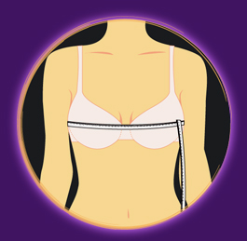
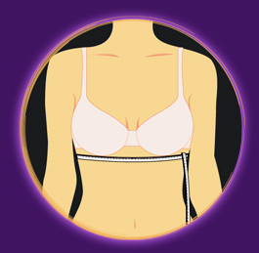
SIZE MEASUREMENT
What do we have to measure to identify bra size ?
Bust
Under Bust
Cup Size
Body Width

Slide 4
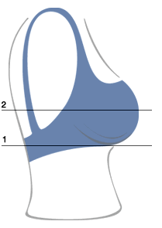
SIZE MEASUREMENT
How to identify cup size if the chart does not available ?
Different (2) – (1) cm | Cup Size
8-9 | AA
10-11 | A
12-13 | B
14-15 | C
16-18 | D
19-21 | E
Bust
Under
Bust

Slide 5
SIZE MEASUREMENT
Bra size identification chart
Under Bust | Bust |  | Bust
 |  |  | Cup Size
 | CM | Inch | AA | A | B | C | D | E
63-67 | 65 | 30 | 73-74 | 75-76 | 77-78 | 79-80 | 81-83
68-72 | 70 | 32 | 78-79 | 80-81 | 82-83 | 84-85 | 86-88 | 89-91
73-77 | 75 | 34 | 83-84 | 85-86 | 87-88 | 89-90 | 91-93 | 94-96
78-82 | 80 | 36 | 88-89 | 90-91 | 92-93 | 94-95 | 96-98 | 99-100
83-87 | 85 | 38 | 93-94 | 95-96 | 97-98 | 99-100 | 101-103 | 104-106
88-92 | 90 | 40 | 98-99 | 100-101 | 102-103 | 104-105 | 106-108 | 109-111
93-97 | 95 | 42 |  | 105-106 | 107-108 | 109-110 | 111-113 | 114-116
98-102 | 100 | 44 |  | 110-111 | 112-113 | 114-115 | 116-118 | 119-121
103-107 | 105 | 46 |  |  | 117-118 | 119-120 | 121-123 | 124-126
108-112 | 110 | 48 |  |  | 122-123 | 124-125 | 126-128 | 129-131
113-117 | 115 | 50 |  |  | 127-128 | 129-130 | 131-133 | 134-136
118-122 | 120 | 52 |  |  | 132-133 | 134-135 | 136-138 | 139-141

Slide 6
SIZE MEASUREMENT
What if the measurement does not fall into the available size?
Measure Range (cm) | Your Size (cm) | Your Size (inch)
63-67 | 65 | 30
68-72 | 70 | 32
73-77 | 75 | 34
78-82 | 80 | 36
83-87 | 85 | 38
88-92 | 90 | 40

Slide 7
SIZE MEASUREMENT
Example I: Bust is 73 cm and Under bust is 92 cm
Under Bust | Bust |  | Bust
 |  |  | Cup Size
 | Sabina | Inch | AA | A | B | C | D | E
63-67 | 65 | 30 | 73-74 | 75-76 | 77-78 | 79-80 | 81-83
68-72 | 70 | 32 | 78-79 | 80-81 | 82-83 | 84-85 | 86-88 | 89-91
73-77 | 75 | 34 | 83-84 | 85-86 | 87-88 | 89-90 | 91-93 | 94-96
78-82 | 80 | 36 | 88-89 | 90-91 | 92-93 | 94-95 | 96-98 | 99-100
83-87 | 85 | 38 | 93-94 | 95-96 | 97-98 | 99-100 | 101-103 | 104-106
88-92 | 90 | 40 | 98-99 | 100-101 | 102-103 | 104-105 | 106-108 | 109-111
93-97 | 95 | 42 |  | 105-106 | 107-108 | 109-110 | 111-113 | 114-116
98-102 | 100 | 44 |  | 110-111 | 112-113 | 114-115 | 116-118 | 119-121
103-107 | 105 | 46 |  |  | 117-118 | 119-120 | 121-123 | 124-126
108-112 | 110 | 48 |  |  | 122-123 | 124-125 | 126-128 | 129-131
113-117 | 115 | 50 |  |  | 127-128 | 129-130 | 131-133 | 134-136
118-122 | 120 | 52 |  |  | 132-133 | 134-135 | 136-138 | 139-141
Size that the person should wear is 34D (Sabina size identification is based on inch basis)

Slide 8
SIZE MEASUREMENT
Example I: Bust is 73 cm and Under bust is 92 cm
Measure Range (cm) | Your Size (cm) | Your Size (inch)
63-67 | 65 | 30
68-72 | 70 | 32
73-77 | 75 | 34
78-82 | 80 | 36
83-87 | 85 | 38
88-92 | 90 | 40
Different (2) – (1) cm | Cup Size
8-9 | AA
10-11 | A
12-13 | B
14-15 | C
16-18 | D
19-21 | E
Different between bust and under bust: 92 - 75 = 17
Size that the person should wear is 34D (Sabina size identification is based on inch basis)

Slide 9
SIZE MEASUREMENT
Example II: Bust is 82 cm and Under bust is 95 cm
Under Bust | Bust |  | Bust
 |  |  | Cup Size
 | Sabina | Inch | AA | A | B | C | D | E
63-67 | 65 | 30 | 73-74 | 75-76 | 77-78 | 79-80 | 81-83
68-72 | 70 | 32 | 78-79 | 80-81 | 82-83 | 84-85 | 86-88 | 89-91
73-77 | 75 | 34 | 83-84 | 85-86 | 87-88 | 89-90 | 91-93 | 94-96
78-82 | 80 | 36 | 88-89 | 90-91 | 92-93 | 94-95 | 96-98 | 99-100
83-87 | 85 | 38 | 93-94 | 95-96 | 97-98 | 99-100 | 101-103 | 104-106
88-92 | 90 | 40 | 98-99 | 100-101 | 102-103 | 104-105 | 106-108 | 109-111
93-97 | 95 | 42 |  | 105-106 | 107-108 | 109-110 | 111-113 | 114-116
98-102 | 100 | 44 |  | 110-111 | 112-113 | 114-115 | 116-118 | 119-121
103-107 | 105 | 46 |  |  | 117-118 | 119-120 | 121-123 | 124-126
108-112 | 110 | 48 |  |  | 122-123 | 124-125 | 126-128 | 129-131
113-117 | 115 | 50 |  |  | 127-128 | 129-130 | 131-133 | 134-136
118-122 | 120 | 52 |  |  | 132-133 | 134-135 | 136-138 | 139-141
Size that the person should wear is 36C (Sabina size identification is based on inch basis)

Slide 10
SIZE MEASUREMENT
Example II: Bust is 82 cm and Under bust is 95 cm
Measure Range (cm) | Your Size (cm) | Your Size (inch)
63-67 | 65 | 30
68-72 | 70 | 32
73-77 | 75 | 34
78-82 | 80 | 36
83-87 | 85 | 38
88-92 | 90 | 40
Different (2) – (1) cm | Cup Size
8-9 | AA
10-11 | A
12-13 | B
14-15 | C
16-18 | D
19-21 | E
Different between bust and under bust: 95 - 80 = 15
Size that the person should wear is 36C (Sabina size identification is based on inch basis)

Slide 11
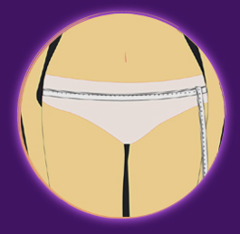
SIZE MEASUREMENT
How to identify panty size?
** Measurement tape must pass the widest points on hip **

Slide 12

SIZE MEASUREMENT
Panty size identification chart
Size | Hip Measure (cm) | Hip measure (inch)
S | 80-88 | 31-34
M | 85-93* | 33-36
L | 90*-98** | 35-38
XL | 95**-103 | 37-40
LL (XXL) | 100-108 | 39-42
EL (XXXL) | 105-113 | 41-43

Slide 13


